Slide 1
Unifying Early Childhood Care and Education at VDOE
BRPO Meeting | July 29, 2021

Slide 2
Overview
Why unify ECCE at the VDOE?
Background on the child care transition and implications for child care licensing and the Child Care Subsidy Program
Updates on efforts to improve access to ECCE
Discussion
Notes:
Kris

Slide 3
Why unify ECCE at the VDOE?

Slide 4
Our shared challenge
All Virginia children are capable of and deserve to enter school ready. Yet too many children enter kindergarten without this opportunity.
According to the 2020 Virginia Kindergarten Readiness Program (VKRP), 45% of Virginia’s Kindergarteners entered school without the key literacy, math, and social-emotional skills needed to be successful
Our “system” fails to prepare 55% of children from economically disadvantaged families and 66% of children with special needs
Virginia ranks 33rd nationally in preschool funding and child care funding is at the 70th percentile; ~50,000 vulnerable three- and four-year-olds lack access to quality preschool
75% of Virginia’s early childhood programs that receive public funding do not participate in the state’s voluntary quality measurement system
The COVID-19 pandemic has exacerbated inequities in the system and led to many young children missing out on learning and development opportunities

Slide 5
Vision
We envision a Virginia where all children have the opportunity to enter school ready, prepared to fulfill their potential.
Families furthest from opportunity should be the priority for affordable access, high-quality options and meaningful family engagement.
All programs that take public funding deserve measurement and supports for improvement, ensuring that quality is not out of reach to families who can’t afford to pay.
Programs are rewarded for classroom quality and growth and educators are more equitably distributed and adequately compensated.
Overall Virginia’s early childhood system will be more unified, transparent, data-driven and resource-effective so we can continue to reduce inequities and increase opportunity.
Virginia can use increased attention and funding in response to COVID-19 to invest in build back better.

Slide 6
Background on the child care transition

Slide 7
Background on the child care transition
Executive Directive 4 called for a plan to ensure that all at-risk 3 and 4-year-olds have access to publicly-funded ECCE and that all publicly-funded programs are measured as part of a quality rating system by 2025
HB 1012 / SB 578 operationalized these recommendations by calling for the Virginia Board of Education (VBOE) to establish a statewide, unified public-private early childhood care and education system
Formally transitions the Head Start State Collaboration Office, child care licensing and monitoring functions, quality improvement functions, and child care subsidy oversight from VDSS into VDOE effective July 1, 2021
Requires the Board to adopt a unified quality measurement and improvement system by July 1, 2021
Requires VDOE to establish an Early Childhood Advisory Committee (ECAC)
Notes:
ED4: 2019, Gov Northan issued Executive Directive 4, calling for a plan to ensure…
Also established a Leadership Team on School Readiness, tasked w/ conducting listening sessions, analyze funding streams, and develop recommendations to consolidate state oversight and administration of early childhood programs in Virginia.
HB 1012/SB 578 operationalized these recommendations…

Slide 8
What does this mean for Child Care Licensing?
VDOE is now “Lead Agency” for the federal Child Care and Development Block Grant (CCDBG) and directly runs child care licensing through the Office of Child Care Health and Safety.
VDOE is responsible for regulating, inspecting, and monitoring child care programs. Child care licensing staff are now VDOE employees.
All licensing rules and regulations transferred to VDOE as-is. This ensured that child care providers would not need to change how they operate to stay licensed.

Slide 9
What does this mean for CCSP?
VDOE is now “Lead Agency” for the federal Child Care and Development Block Grant (CCDBG), the primary source of funding for child care assistance and quality improvement initiatives.
VDOE oversees and sets policy for the Child Care Subsidy Program for working families with low incomes.
Subsidy regulations, program guidance transferred to VDOE as they are.
VDSS will continue to administer the program via its network of 120 Local Departments of Social Services.
Families will still go to their local social service office to apply for assistance and providers will still apply to become a subsidy vendor through VDSS.

Slide 10
CCSP oversight as of July 1, 2021
Federal Office of Child Care
Board of Education
Promulgates regulations related to the CCSP
Federal authority over the Child Care and Development Block Grant, which funds the CCSP
Is CCDF Lead Agency
Sets CCSP policy, including eligibility rules, reimbursement rates, etc.
Oversees VDSS administration of the voucher program
VDOE
VDSS
Oversees case management activities in LDSS offices
Recruits and enrolls providers; processes payments
Regional consultants
LDSS Offices
Provide case management services to families, including processing applications, helping parents choose child care providers; conducting annual redetermination checks
Provide policy support to LDSS offices
Answer questions from parents and providers

Slide 11
VDOE roles and responsibilities
As of July 1, 2021, VDOE became Lead Agency for the Child Care and Development Block Grant (CCDBG).
Fiscal | Policy | Program Administration | Communications
Receive federal funds directly from HHS Reimburse VDSS for services provided as a subrecipient Establish spending priorities for the CCSP | Set policy and regulations for child care under oversight of the VBOE Regularly review and approve the Child Care Subsidy Program Guidance Manual | Oversee administration of the CCSP, including contracted activities Work with VDSS to establish child targets and local allocations, including adjustments throughout the year Work with VDSS to establish “provider targets” to increase the number of subsidy vendors | Develop consumer education materials Provide guidance for and approve CCSP materials issued by DSS Maintain the child care microsite Serve as primary contact for inquiries from media, state and federal policymakers related to the CCSP Maintain social media accounts for CCSP

Slide 12
VDSS roles and responsibilities
VDSS is now a subrecipient to VDOE and is contracted to administer the CCSP through its network of 120 LDSS offices.
Fiscal | Policy | Program Administration | Communications
Be reimbursed for services performed related to CCSP administration Provide local administrative support and funding to LDSS offices Work with VDOE to set an annual operating budget Initiate an administrative appropriation transfer each year Ensure VDOE has a current copy of the HHS cost allocation plan at all times | Ensure VDSS and LDSS staff are implementing CCSP activities in adherence to policy set by VDOE Propose changes to policy and/or process to VDOE Issue updates to the CCSP at least annually Share upcoming benefit policy changes that may affect CCSP participants | Oversee intake, eligibility, and case management functions within LDSS offices, including conducting regular monitoring and training staff Monitor and recommend adjustments to child targets Facilitate provider recruitment, application/enrollment, and orientation into the CCSP Process vendor payments Carry out the regular error rate review process with OCC Initiate collections for overpayments to providers | Develop and distribute CCSP publications according to VDOE guidance Oversee and administer the public benefits call center Maintain comprehensive records of constituent communications Direct requests from media and state or federal policymakers to VDOE

Slide 13
Key transition milestones in 2021-2022
July 1, 2021: VDOE has official oversight of child care in Virginia
Fall 2021: VDOE begins stakeholder engagement with the field related to child care subsidy and licensing regulations
Winter 2021/2022: VDOE reviews child care regulations with the ECAC
Spring 2022: VDOE brings child care regulation changes to the Board of Education

Slide 14
Updates on efforts to improve access

Slide 15
Fall 2022 preschool enrollment
Virginia Preschool Initiative (VPI)
VPI funding increased by 20 percent for the 2021-2022 school year
126 school divisions are planning to offer a VPI program, serving over 22,000 4-year-olds and over 1,500 3-year-olds.
35 divisions requested the opportunity to serve more four-year-olds than initially allocated.
37 divisions have opted to participate in the three-year-old pilot.
Mixed Delivery Grant Program
The program will expand from 9 to 45 jurisdictions in the 2021-2022 school year and increase the number of children enrolled from 250 to nearly 1,500
One-third of all Virginia localities will now offer preschool services through the Mixed Delivery Grant Program
Head Start
Collectively, Head Start and Early Head Start grantees are funded to serve 14,463 children in the 2021-2022 school year
Notes:
Virginia’s two largest state supported preschool programs have reported historic levels of interest in planning for the 2021-2022 school year: Virginia Early Childhood Foundation (VECF) Mixed Delivery and the Virginia Preschool Initiative (VPI)

Slide 16
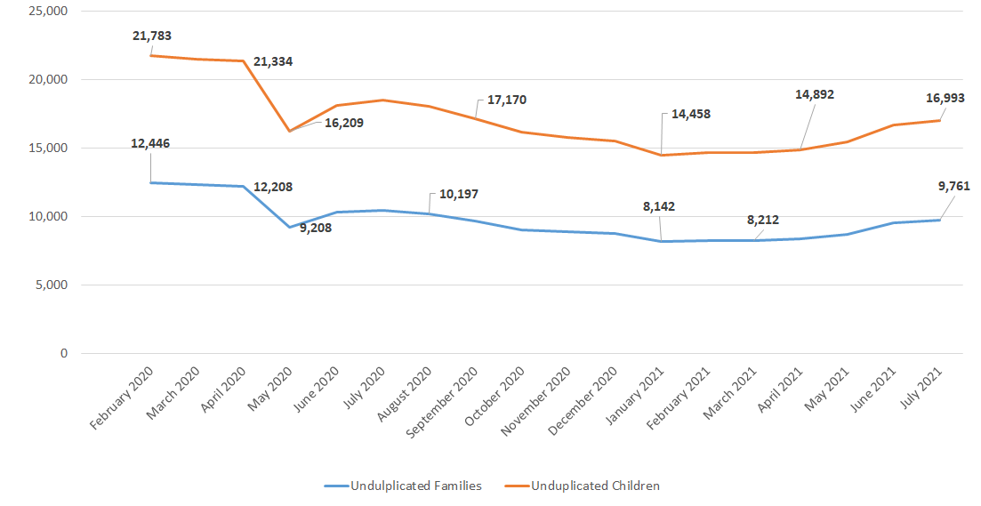
Child Care Subsidy Program participation is slowly increasing

Slide 17
Using COVID-19 Relief Funding
Virginia has approximately $1 billion in CCDBG pandemic relief funding to support children, families, and child care providers by:
Providing direct aid to child care providers
Restoring the Child Care Subsidy Program
Increasing child care supply in underserved communities
Improving quality and supporting the workforce

Slide 18
What does equity in access to child care look like?
A child’s race, ethnicity, home language, immigration status, or zip code is not predictive of their participation in or the availability of high-quality child care in their community
Families have a full array of high-quality, affordable options in their community, regardless of whether or how they pay for care
Families with the fewest resources receive the most support to participate in care

Slide 19
Putting equity at the forefront of our relief efforts
Focusing supply-building activities in historically marginalized communities and honoring parents’ needs & preferences.
Prioritizing subsidy providers & providers in high-need communities for Stabilization Grants.
04
01
03
Maximizing eligibility in the Child Care Subsidy Program while eliminating barriers that limit access among children of color and families in poverty.
Ensuring that quality improvement and workforce supports are available to providers regardless of setting.
02

Slide 20
ARPA Child Care Stabilization Grants
VDOE will be issuing grants to eligible child care providers on a quarterly basis for up to 12 months beginning this fall. Grants will be based on:
Open/closed status
Licensed or approved capacity
Participation in the Child Care Subsidy Program
Location in a high-need community
Grants will allow providers to cover higher operating costs, invest in staff, make minor facility improvements, and purchase equipment and supplies.

Slide 21
Expanding access to the Child Care Subsidy Program
In March 2021, Governor Northam signed legislation temporarily expanding eligibility for the Child Care Subsidy Program. VDOE recently was approved to extend expanded eligibility until December 31, 2021.
All families receiving child care assistance will not owe copayments through 12/31/21.
Parents can get help paying for child care under job search if they: | Parents can get help paying for child care under expanded income eligibility if they:
Have a child ages 12 or younger; Meet income eligibility requirements based on their locality; and Are searching for employment. | Have at least one child ages 5 or younger, not yet in kindergarten; Are working, participating in education or training, or searching for work; and Their household income exceeds eligibility levels in their locality but is below 85 percent of the state median income.

Slide 22
Three key steps to restoring the CCSP
Make more families eligible, make it easier to apply and enroll, and reduce family co-pays
Make it easier and more attractive for child care programs to become subsidy vendors
Increase provider payment rates to cover the actual costs of child care

Slide 23
Discussion: Increasing participation in the CCSP
What is working well about CCSP policies or processes right now?
Where are the biggest challenges or bottlenecks in the application and enrollment process for families?
If you could change one thing about the CCSP to make it easier for families to participate, what would it be?
Notes:
Notes: uploading documents with CommonHelp; need for additional staffing/capacity to work w/ families in local offices; often hearing that families can’t get spots in providers; in ALX trying to help providers hire qualified teachers;

Slide 24
Thank you!
Rebecca Ullrich
Director, Office of Early Childhood Access and Enrollment
Email earlychildhood@doe.virginia.gov with questions and comments

