Slide 1
Welcome to the Virginia Weatherization Assistance Program! Presented by Susan Hill VA Department of Housing and Community Development

Slide 2
Weatherization Assistance Program
WAP funded by U.S. Department of Energy;
LIHEAP funded by Health and Human Services;
Operated in all 50 States, District of Columbia, US Territories and some Native American Tribes;
Utilizes some of the most advanced technologies and diagnostic testing protocols in the energy conservation industry today

Slide 4
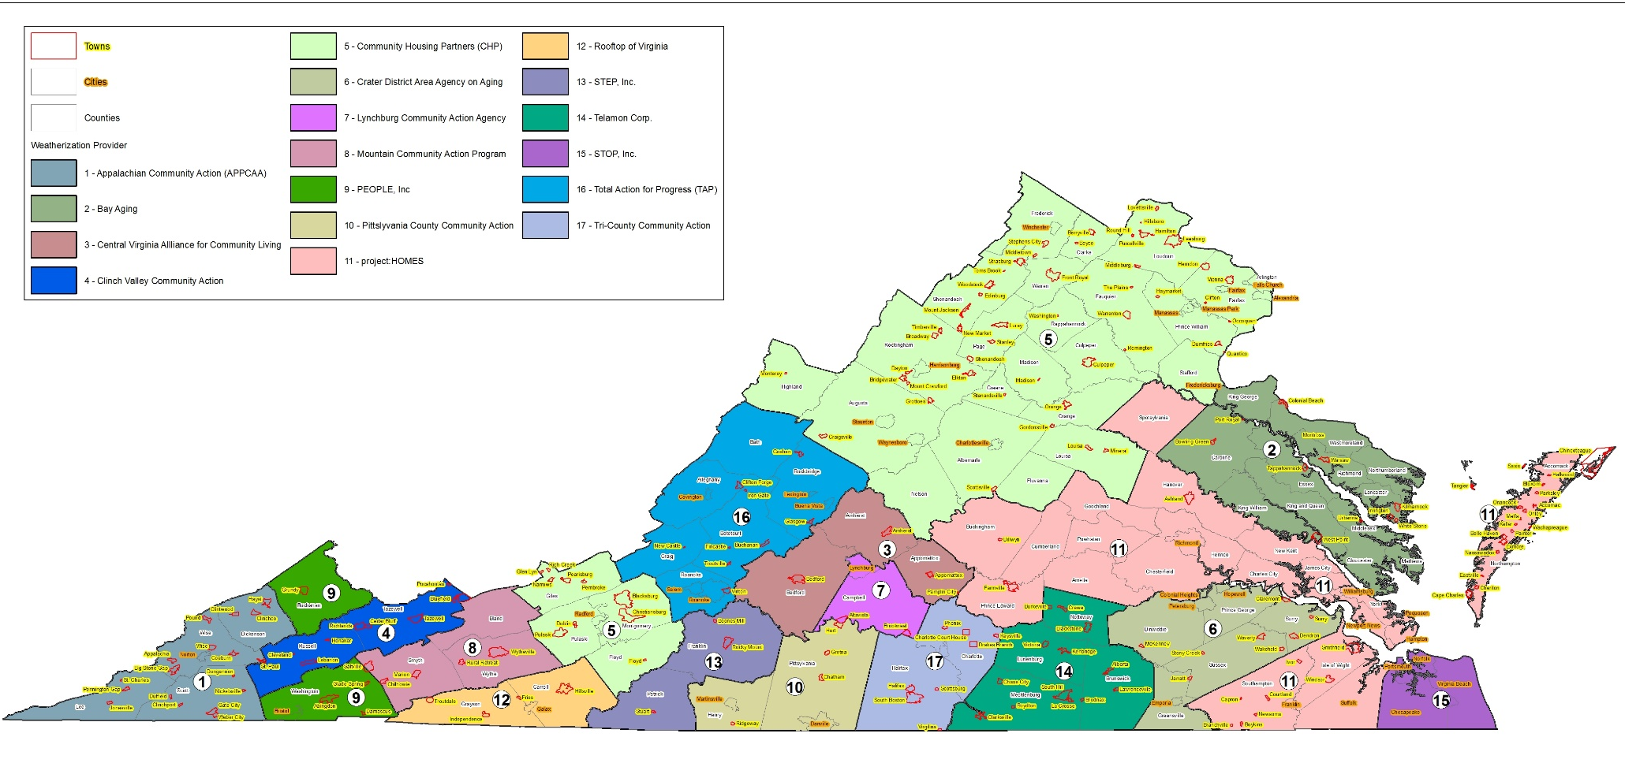
VA Weatherization Providers
Richmond and surrounding counties:
project:HOMES 804-233-2827

Slide 5
Virginia Funding Levels
$4.4 million per year from DOE
Plus 15% of State’s LIHEAP allocation – approximately $13.7 million annually
Average cost per unit over $7,000
Providers may leverage utility dollars

Slide 6
Virginia WAP Program
Administered through 17 local non-profit subgrantee agencies statewide;
Targeted to households at or below 60% of median income, with priority to:
elderly
disabled
families with young children

Slide 7
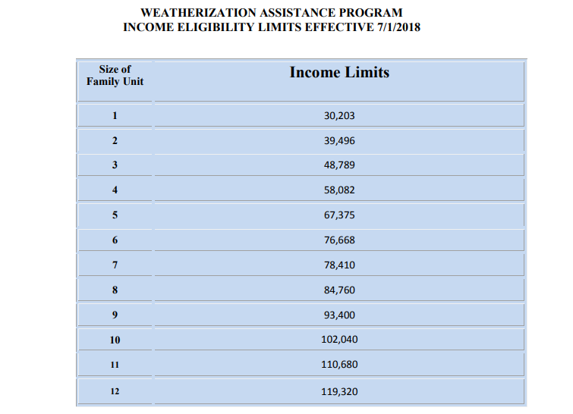
WAP Income Limits

Slide 8
Virginia WAP Program
Available for single family, mobile homes, and multi-family
Available to owners and renters
Renters must have landlord written permission
Large multi-family must have landlord contribution
Landlord must agree not to raise rent for reasonable period of time

Slide 9
Virginia WAP Program
Any house that received Wx on or after 9/30/1994 cannot be re-weatherized.
Weatherization follows the physical address.
An eligible family who receives services and moves to a different home can apply for weatherization services at the new address.
Houses in need of substantial repairs where the weatherization work would be compromised are deferred or denied.

Slide 10
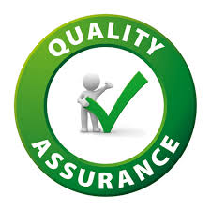
State Role
Management, oversight and reporting of DOE and LIHEAP funds in accordance with regulations
Fiscal and administrative monitoring
Technical monitoring and inspection of 5-10% of units completed

Slide 11
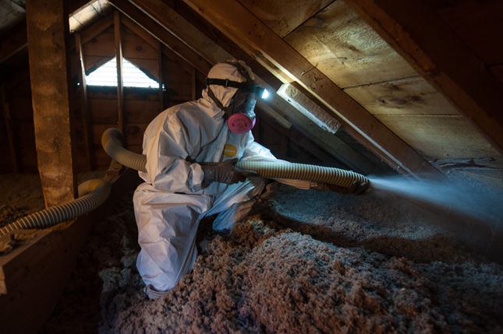
WAP Provider Role:
Applicant Intake and Approval
Energy Audit and Inspection
Work Order for each Job
Installation of Weatherization Measures
Client Education
Inspection by Quality Control Inspector

Slide 12
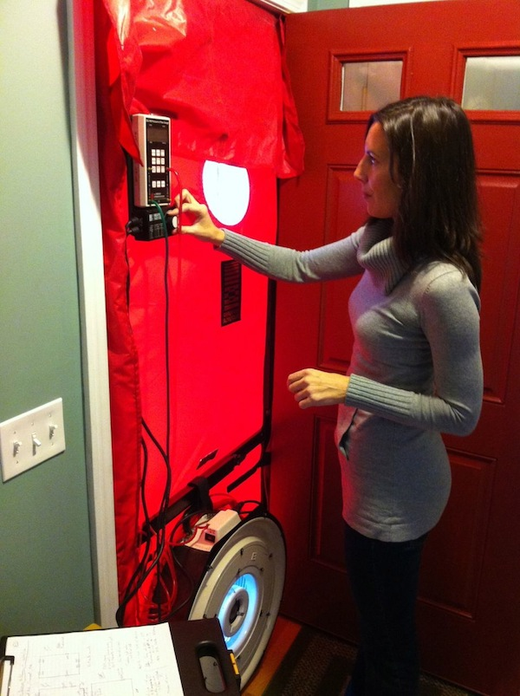
VA has a highly trained weatherization workforce!
Crew workers
Crew leaders
Energy Auditors
Quality Control Inspectors

Slide 13
https://www.youtube.com/watch?v=r0Vw1Mqu5hE

Slide 14
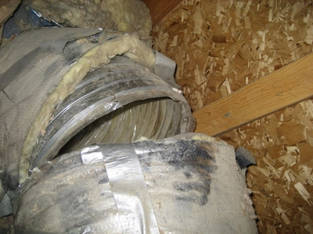
Common Measures
Duct sealing
Air sealing
Insulation (belly, ceiling/roof cavity, walls)
Lighting
Insulation of hot water heater
Furnace and boiler tune-up
Refrigerator replacement
Smoke / CO detectors
Whole House Ventilation Fans

Slide 15
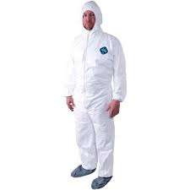
Health & Safety
For benefit and durability of weatherization measures installed and safety of residents/crew
Incidental Roof repair (no replacement)
Dryer venting/moisture control
Fire extinguisher
Combustion appliance inspection/safety
Personal protection equipment for crew

Slide 16
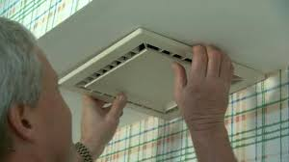
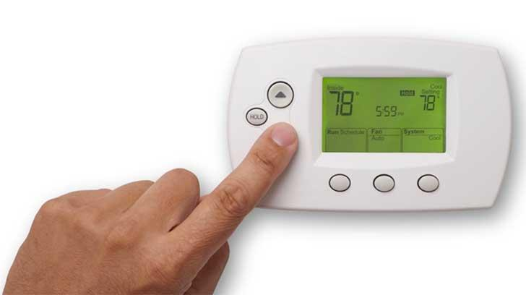
Client Education
Operating new equipment
Maintaining equipment for maximum efficiency
Other tips on saving energy in the home

Slide 17
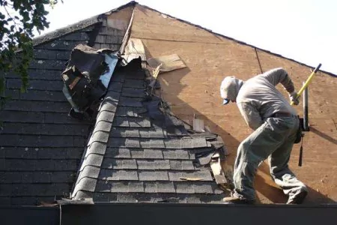
Weatherization does NOT:
Eliminate mold
Abate lead paint
Remove asbestos
Replace roofs
Provide general home repairs/painting
Build outside decks or stairs
Replace ranges (can clean/repair)

Slide 18
Utility Funded Programs
Offered by the same network of weatherization providers
Can help clients who don’t qualify for state weatherization program

Slide 19
Utility Funded Programs
And service for veterans too!

Slide 20
Multiple Benefits of Weatherization
35% less energy consumption
$250-450 less spending on energy annually
Emissions reductions
90% of materials used are ‘Made in USA’
Increased health and safety benefits

Slide 21
Thank you!
Susan Hill
Housing Program Administrator
804.371.0671
susan.hill@dhcd.virginia.gov

